Slide 1
MGS 425 (S1S & S2S) Management of it projects
Week 8 – March 22nd

Slide 2
Agenda
Chapter 14 – Scrum Planning Principles
TopHat assignment will be given based on material from this week.
REMINDER: Deliverable 1 for the Final Term Paper
Due date is 11:59 pm, Sunday, March 28th.

Slide 3
Scrum planning principles
Chapter 14

Slide 4
Scrum Planning Principles
Chapter Agenda – Start of Planning Section of the Book
Overview
Don’t Assume We Can Get the Plans Right Up Front
Up-Front Planning Should Be Helpful without Being Excessive
Keep Planning Options Open Until the Last Responsible Moment
Focus More on Adapting and Replanning Than on Conforming to a Plan
Correctly Manage the Planning Inventory
Favor Smaller and More Frequent Releases
Plan to Learn Fast and Pivot When Necessary
Closing

Slide 5
Scrum Planning Principles – Overview
Chapter Summary
A common myth states that development with Scrum takes off with no planning. We just start the first sprint and figure out the details in flight. This isn’t true.
We do real planning in Scrum. In fact, we plan at multiple levels of detail and at many points in time. To some it may seem like Scrum deemphasizes planning because a majority of the planning occurs just in time instead of substantially up front.
Teams often spend more time planning with Scrum than with traditional development; it just might feel a bit different.

Slide 6
Scrum Planning Principles
Don’t Assume We Can Get the Plans Right Up Front
The traditional, predictive approach to planning is to create a detailed plan up front before development work begins.
The goal is to get it right so that the rest of the work can proceed in an orderly fashion
The Scrum approach to planning is true to its empirical roots of inspection and adaptation.
When developing using Scrum, we don’t believe we can get it right up front, so we don’t try to produce all of the planning artifacts up front.
Some of the planning artifacts are created early on in order to achieve a good balance between up-front and just-in-time planning.

Slide 7
Scrum Planning Principles
Up-Front Planning Should Be Helpful without Being Excessive
On the products where a team creates a detailed up-front plan, this approach rarely works out.
Planning at this level of detail is wasteful; believing the plan is correct to the point of ignoring real-time data is downright dangerous.
This does does that mean we should do no up-front planning.
It is important to find the proper balance between up-front prediction and just-in-time adaptation.
Notes:
Let’s look at an example that illustrates the principle that up-front planning should be helpful without being excessive.
I live in Colorado where the skiing is world-class. Occasionally I do some recreational skiing, but I’m no expert. A friend of mine, John, is an extreme skier. Honestly, there are times I wish I were one as well, but I’m not that skilled or that crazy; John is. Once John was sharing pictures of his adventures on a particularly insane mountain. Out of curiosity I asked him a simple question: “When you are positioned at the top of the mountain preparing to start your run, do you plan your entire route down?”
After he finished chuckling, he remarked, “No, if I did that I would just get myself killed.” He went on to say, “I pick a spot some distance down the mountain. My first goal is to ski to that spot. Maybe I plan the first two or three turns. Realistically, planning any further would be impossible and dangerous.”
“Why?” I asked.
“The terrain isn’t what it appears to be from the top because the lighting and other factors play tricks on you. Also, there are probably some trees down there somewhere, but from up top I can’t see them—if I decide while standing at the top to turn right at some point, and actually follow through on it, I might fly right into those trees. Plus there’s no predicting the 15-year-old on a snowboard who will fly over my head yelling, ‘Watch out, dude!’ You never know when you’ll have to change course, or why.”

Slide 8
Scrum Planning Principles
Keep Planning Options Open Until the Last Responsible Moment
To achieve a good balance between up-front and just-in-time planning, we are guided by the principle that we should keep important options open until the last responsible moment.
This means we save the planning that is best performed in a just-in-time fashion for a time when we have much better information.
Why make an early planning decision based on poor information? In addition to being very costly, premature decision making can also be dangerous.

Slide 9
Scrum Planning Principles
Focus More on Adapting and Replanning Than on Conforming to a Plan
One of the issues on many product development efforts is that too much emphasis is placed on the up-front plan and not enough on continuous planning.
If we spend significant time up front developing a highly predictive plan, and we believe we’ve got it right, there will be significant inertia to conform to the plan instead of updating it to respond to change.
If we believe instead, as we do with Scrum, that you can’t get the plans right up front and you can’t eliminate change, we will value responding to change and replanning over following the up-front plan.
In Scrum, we favor frequent replanning as we validate our assumptions. We use our validated learning to continuously produce better, more useful plans.

Slide 10
Scrum Planning Principles
Correctly Manage the Planning Inventory
When determining the proper balance between up-front and just-in-time planning, a key insight is to realize that creating a large inventory of predictive, not-yet-validated planning artifacts is potentially very wasteful.
Correctly managing our inventory of planning artifacts is the economically sensible thing to do.
As the development effort unfolds and we validate our assumptions by acquiring knowledge about what we’re doing, we’ll learn where our original plan was wrong and how it needs to adapt to new information.

Slide 11
Scrum Planning Principles
Favor Smaller and More Frequent Releases
Scrum favors smaller, more frequent releases because they provide faster feedback and improve a product’s return on investment (ROI).
Lifecycle profits of our product are likely to improve by leveraging incremental development and multiple releases of smaller marketable subsets of features.

Slide 12
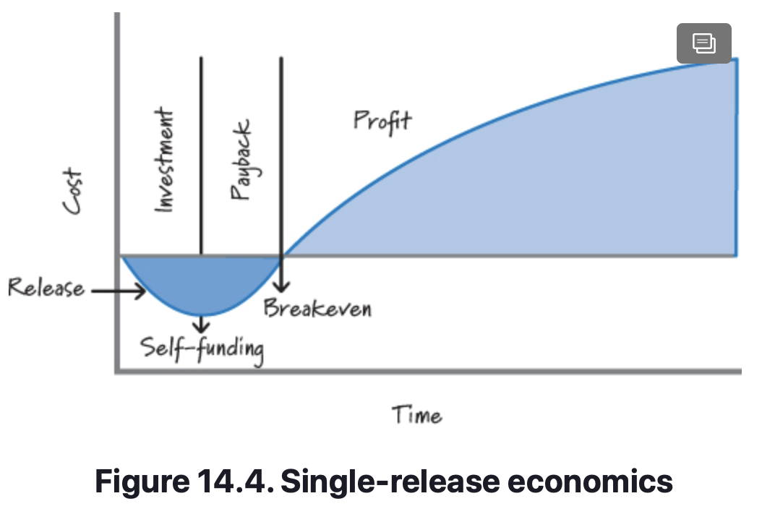
Scrum Planning Principles
Favor Smaller and More Frequent Releases
Consider the economics of a single-release product, as shown in Figure 14.4 (from Denne and Cleland-Huang 2003).
At the beginning of development we are spending money (starting the investment period) without any return.
The release of the product occurs on the downward slope of the curve during the investment period.
Eventually we achieve self-funding, when the product’s revenue equals the cost of development. Once revenues exceed costs, we enter the payback period, where we start to recoup our investment. When total revenue equals total costs, we have achieved the breakeven point.
From that point forward, the product is considered to be profitable.

Slide 13
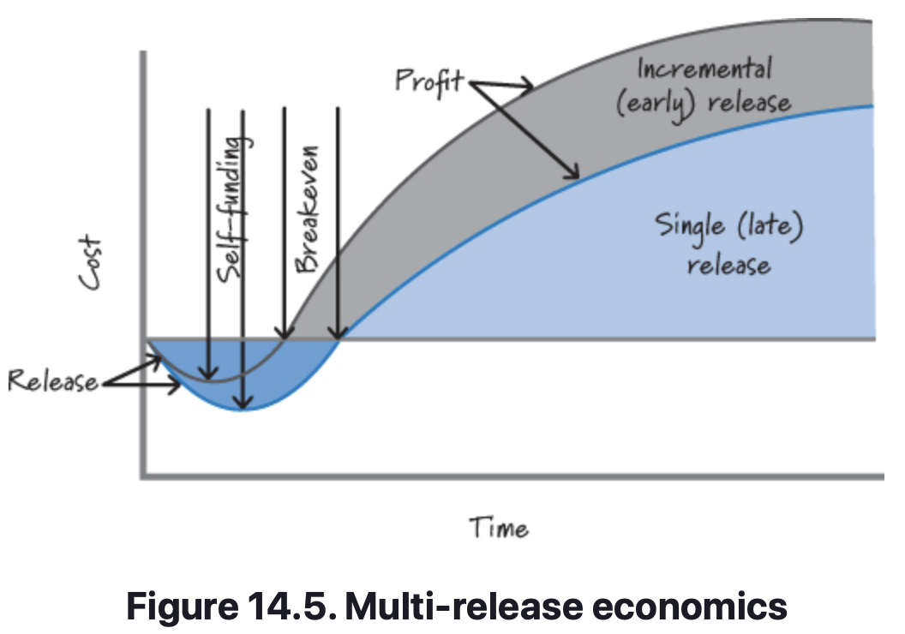
Scrum Planning Principles
Favor Smaller and More Frequent Releases
To illustrate the benefits of smaller, more frequent releases, assume we release twice instead of once (see Figure 14.5). In this case we reach self-funding, breakeven, and profitability sooner, thus improving the overall ROI for the product.

Slide 14
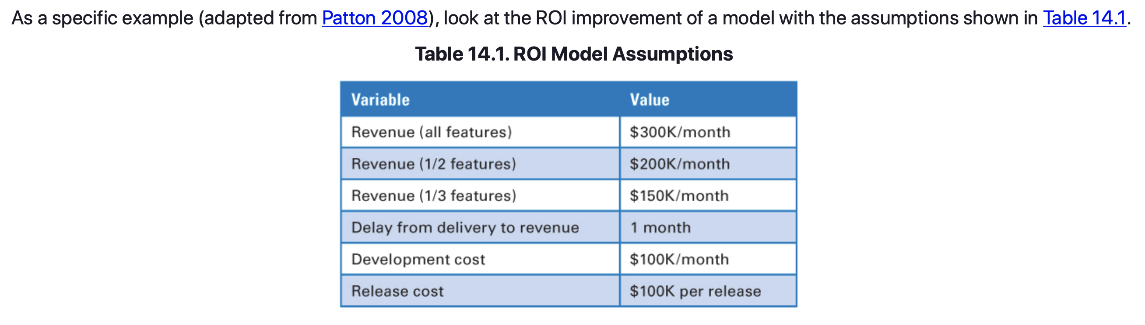
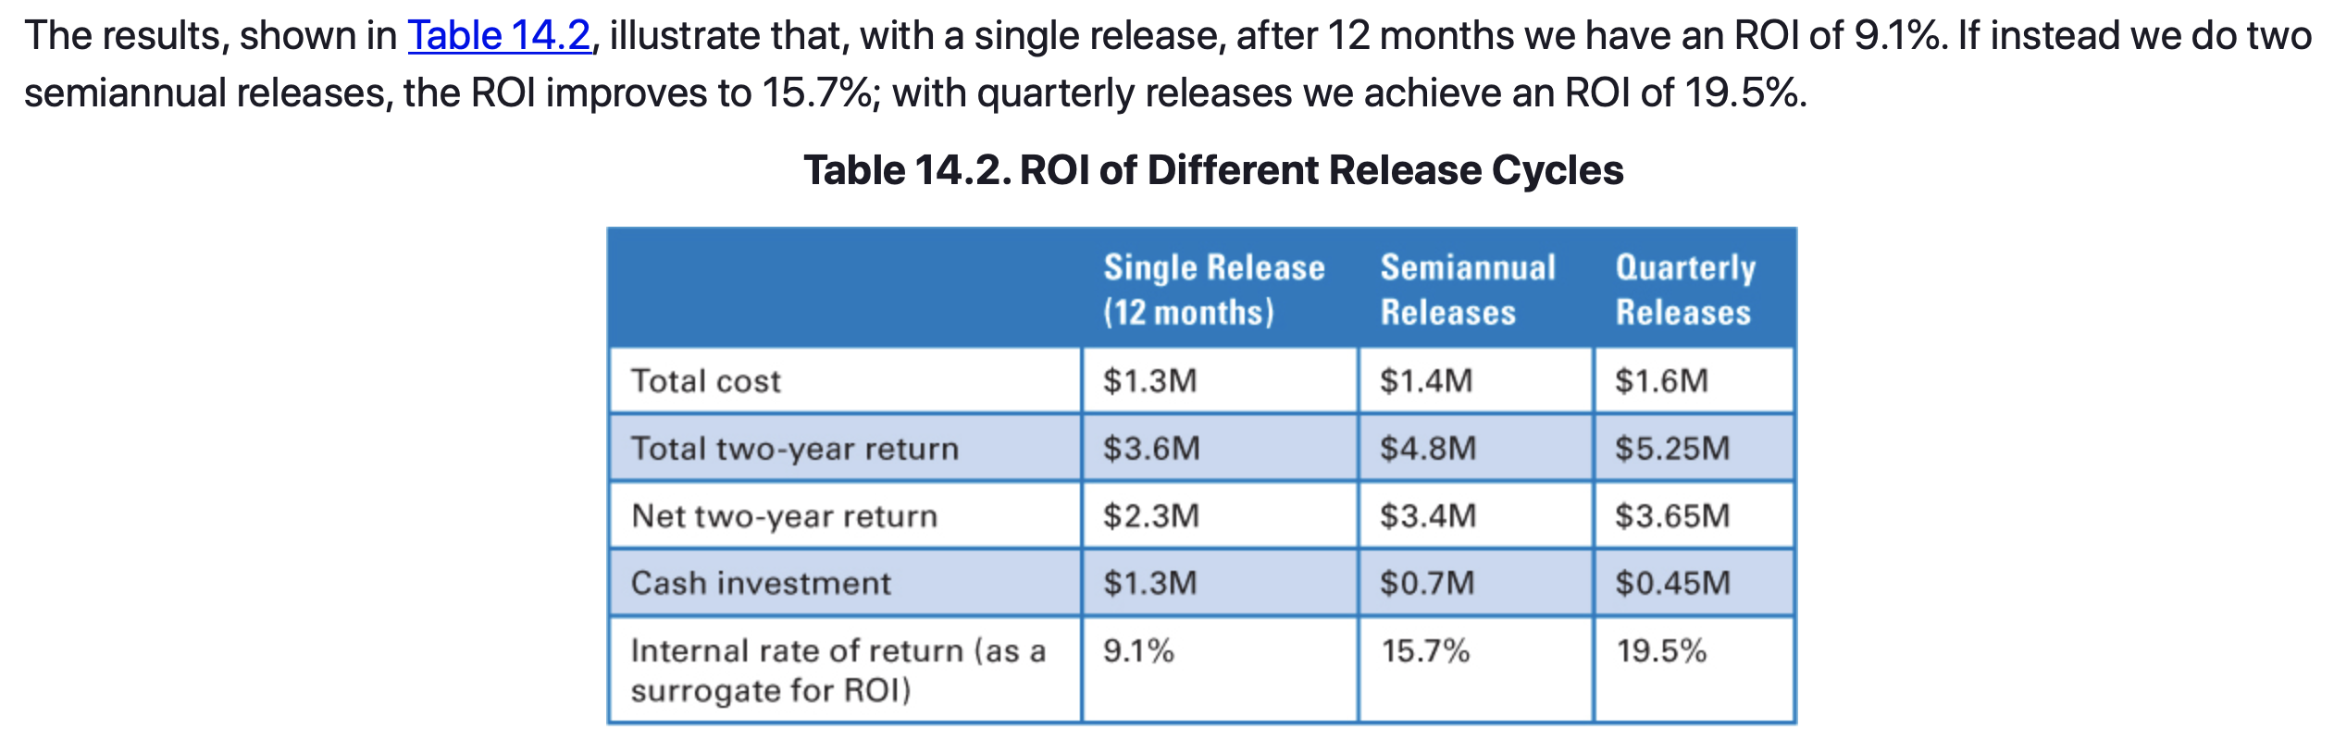
Scrum Planning Principles
Favor Smaller and More Frequent Releases

Slide 15
Scrum Planning Principles
Favor Smaller and More Frequent Releases
There are some limitations to this approach.
First, for any product there is a minimum releasable or marketable set of features.
Therefore, we can’t just continue making the initial release smaller, because eventually it becomes so small as to not be marketable.
Also, in some markets smaller and more frequent releases might not be an option.
However, if your marketplace is open to receiving partial value sooner, delivering smaller and more frequent marketable releases is a very important principle to follow.

Slide 16
Scrum Planning Principles
Plan to Learn Fast and Pivot When Necessary
There is no amount of up-front predicting or guessing that will replace doing something, learning fast, and then pivoting if necessary.
Pivoting means changing directions while staying grounded in what we’ve learned.
Ries defines pivoting to be “a structured course correction designed to test a new fundamental hypothesis about the product, strategy, and engine of growth” (Ries 2011).
Our goal is to move through the learning loop quickly and economically. So we should structure our plans with learning as a key goal. By getting fast feedback, we can determine whether our plans are taking us in a viable direction. If not, we can pivot or redirect ourselves.

Slide 17
Scrum Planning Principles
Closing
Discussed and provided an overview of several Scrum planning principles.
These principles enable us to plan in an economically sensible fashion by doing a helpful amount of up-front planning, balanced with more detailed, just-in-time planning as we learn more about what we are building and how to build it.

Slide 18
Sources
Unless otherwise noted, all material in these slides were used from the textbook for this course:
Rubin, Kenneth S., Essential Scrum: A Practical Guide to the Most
Popular Agile Process, 1st Edition. Addison-Wesley Professional; 1st
edition (August 5, 2012). ISBN-13: 978-0137043293.

